Slide 2
Overview
Part 1 – The Design Space
Part 2 – Propagation Delay and Timing
Part 3 – Asynchronous Interactions
  Types of Interactions
  Combinational Hazards
  Synchronization
  Metastability
  Synchronous Circuit Pitfalls
Part 4 - Programmable Implementation Technologies

Slide 3
Types of Interactions
Differ by
  Source circuit type
  Destination circuit type
Sequential circuit types
  Synchronous – time of state change determined by a clock
  Asynchronous – time of state change controlled by time of input changes and combinational circuit delay
Four possible pairings
  Asynchronous to Asynchronous
  Synchronous to Asynchronous
  Asynchronous to Synchronous
  Synchronous to Synchronous

Slide 4
Types of Interactions
Asynchronous to Asynchronous – not of concern since we are not covering general asynchronous circuit design
Synchronous to Asynchronous – synchronous circuit outputs must be free of hazards
Asynchronous to Synchronous – inputs must be synchronized to synchronous circuit clock
Synchronous to Synchronous
  Clocks synchronized with each other (including identical) – normal clock timing constraints must be obeyed.
  Clocks not synchronized –inputs must be synchronized to receiving synchronous circuit’s clock

Slide 5
Types of Interactions
Synchronous
Asynchronous
circu
i
t
c
i
rc
u
i
t
(
a
) Synchro
n
ous to async
h
rono
u
s
Asynchronous
Async
h
rono
u
s si
g
na
l
s
Sy
nchronous
circu
i
t
circui
t
(
b)
A
sync
h
rono
u
s
t
o
s
y
n
chro
n
ou
s
Asynchro
n
ous sig
Sy
n
c
hron
o
u
s
n
al
s
Sy
n
c
hron
o
u
s
circui
t
circui
t
Cl
o
c
k X
Cl
o
c
k
Y
(c) Synchro
n
ous circu
i
t
s with unre
l
a
t
e
d clo
c
ks

Slide 6
Synchronous to Asynchronous
Since the asynchronous circuit state changes in response to input changes, there must be no “glitches” in the outputs of the synchronous circuit.
Such glitches can arise from:
  combinational output logic or
  input signals propagating through the synchronous circuit
In order to avoid “glitches”
  the outputs of the synchronous circuit must be Moore outputs, and
  The output logic driving the asynchronous circuit must be free of combinational logic hazards
Satisfying these two requirements is too complex for consideration here and is covered in the reading supplement Combinational Hazards.

Slide 7
Remaining Interactions
Includes asynchronous circuits to synchronous circuits and synchronous circuits to synchronous circuits with unsynchronized clocks
The problem: Input signal changes arrive at flip-flop inputs during the setup time – hold time interval.
The solution:
  Synchronize input signals with the receiving circuit clock
  Otherwise, guarantee that specific input signals will not arrive at flip-flop inputs during the setup time – hold time interval.
  We will focus on the first approach only.

Slide 8
The Problem
Changes in inputs to a synchronous circuit arrive at inputs to two or more circuit flip-flops during the setup-hold time interval. (For simplicity, D flip-flops are assumed.)
When this occurs, the flip-flops may respond differently, e.g., one flip-flop may change its state and another may not change its state, resulting in an incorrect state.

Slide 9
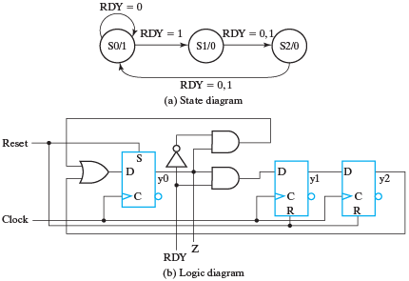
Problem Example
Both illustrations use the same
circuit

Slide 10
Problem Example
State | State Variable = 1
S0 | y0
S1 | y1
S2 | y2
Both illustrations use the same
circuit
The circuit has three states and
uses a 1-hot state assignment:
The circuit interacts with
its environment using two
signals, Z and RDY. When the circuit enters state S0, it signals to the environment with Z = 1. In response, the environment signals back that it is ready to move to state S1 with asynchronous input RDY = 1.

Slide 11
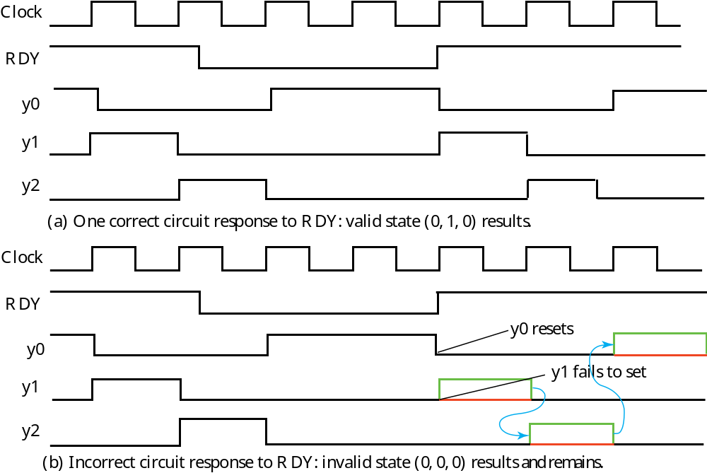
Illustration 1 of the Problem
Notes:
If RDY changing to 1 is sensed by both flip-flop y0 and flip-flop y1, then y0 becomes 0 and y1 becomes 1at the positive clock edge. This is illustrated in (a).
If RDY changing to 1 is sensed only by flip-flop y0, then y0 changes to 0 and y1 remains at 0. This gives state (0,0,0). With no 1 present, this state persists forever and the circuit no longer works as illustrated in (b). This is the first form of possible failure due to inconsistent response of the flip-flops to the change in RDY occurring at the flip-flop inputs during the set-up hold interval for the flip-flops.

Slide 12
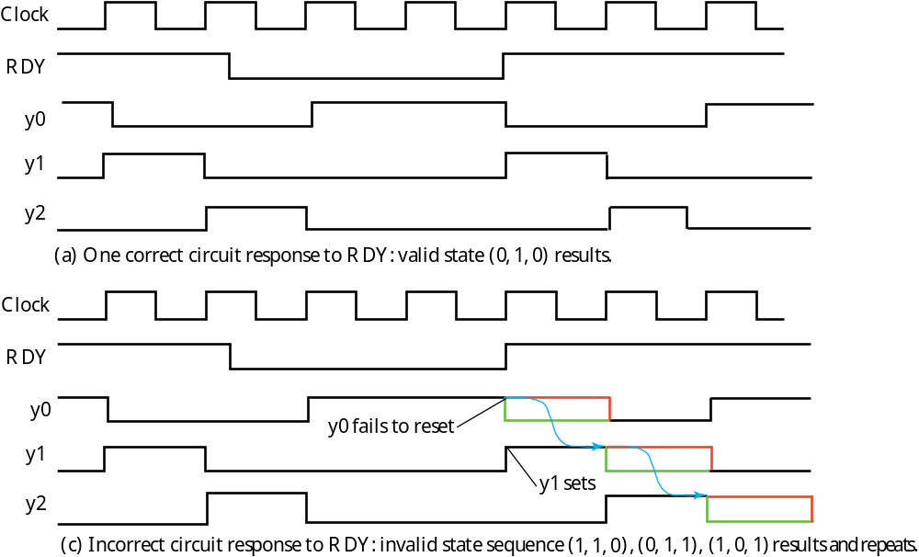
Illustration 2 of the Problem
Notes:
The correct response involving both flip-flops sense RDY’s 1 value is that same in (a) as for Illustration 1.
If RDY changing to 1 is sensed only by flip-flop y1, then y1 changes to 1 and y0 remains at 1. This gives state (1,1,0). As additional clock pulses occur, this state sequence becomes (1,1,0), (0,1,1) and (1,0,1) as shown in (b) which continues to repeat. There are still three states, but clearly the output Z is no longer correct. This is the second form of possible failure due to inconsistent response of the flip-flops to the change in RDY occurring at the flip-flop inputs during the set-up hold interval for the flip-flops.

Slide 13
Solution using Synchronizers
Goal of solution: Preventing the inconsistent response of two or more flip-flops to the change in RDY by preventing RDY from reaching the input of more the one circuit flip-flop.
Implementation: Place a D flip-flop in the path from RDY to the circuit.

Slide 14
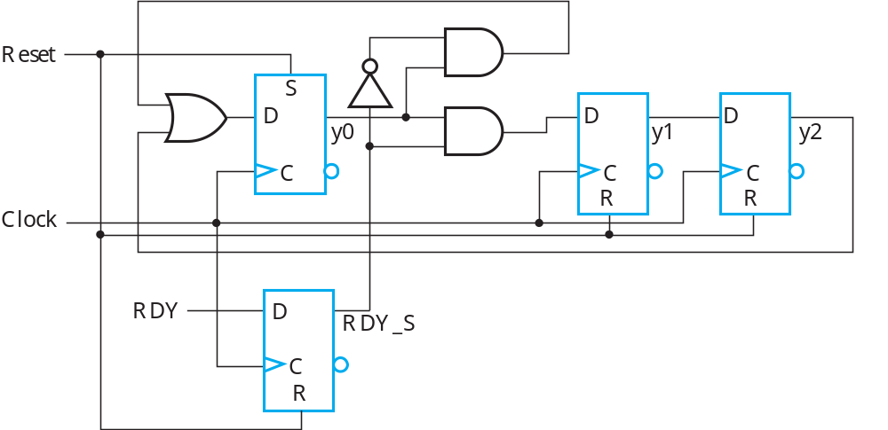
Example Circuit with Synchronizer
_{Synchronizer}

Slide 15
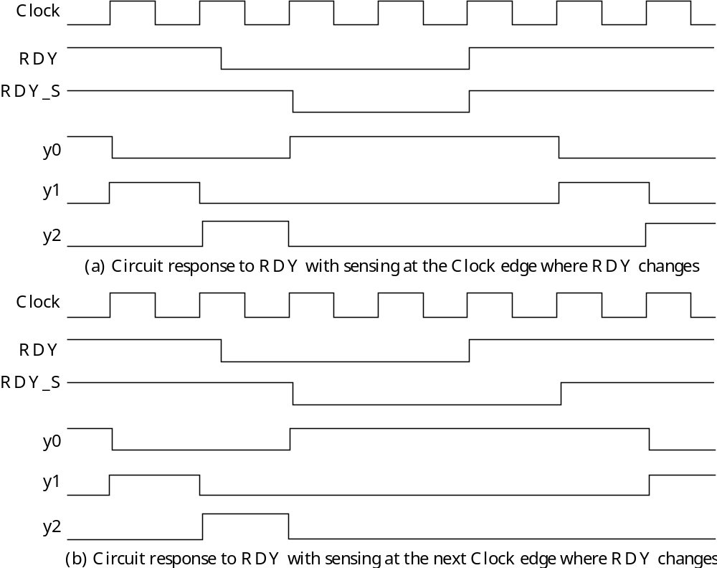
Circuit Behavior with Synchronizer
Assumption 1: If RDY changes during setup-hold interval, synchronizer either responds with corresponding change or not.

Slide 16
Circuit Behavior with Synchronizer
Assumption 2: If RDY change missed during setup-hold interval, change will be captured at next clock edge.

Slide 17
Circuit Behavior with Synchronizer
Condition 1: In order to allow the previous pair of situations to capture the changed value of RDY, the time interval at which RDY retains its new value is constrained as follows:
t_{RDY} > t_{s} + t_{P} + t_{h}
in which t_{s} is the setup time, t_{P} is the clock period and t_{h} is the hold time.
The time at which RDY is captured may differ by a clock cycle. Since the timing of the asynchronous circuit signal RDY is unknown with respect to the clock, the circuit must be designed to work correctly within this capture variation, including capture variation of multiple asynchronous inputs.

Slide 18
Metastability
Unfortunately, Assumption 1 given earlier is not correct. The synchronizer does not respond to an input change during the setup-hold interval by either changing or not.
If the change in RDY at the D input to the synchronizer flip-flop occurs in a very small window within the setup-hold time interval, then metastable behavior can occur.
The window width is of the order of 10 picoseconds (pico = 10⁻¹²⁾.

Slide 19
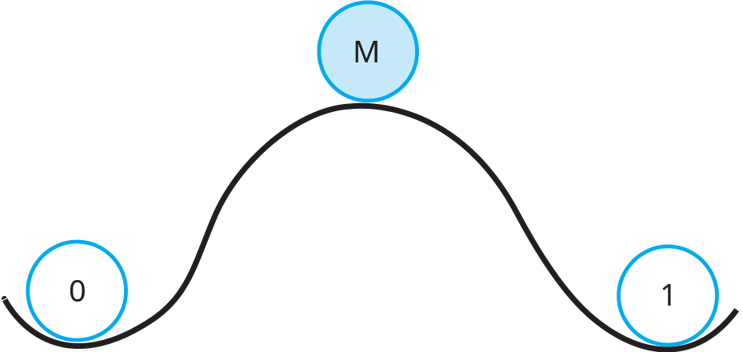
Metastability Concept
The concept of metastability can be illustrated by a mechanical analogy
In positions 0 and 1, the ball is stopped in a stable state. In position M, the ball is stopped in a unstable state between 0 and 1 and remains there until perturbed by, for example, the wind.
The metastable state in a flip-flop latch can be attained by logical ANDing of the RDY change close to a Clock change that produces a very weak output pulse.
Departure from the metastable state is produced by electronic “noise” injected into the flip-flop latch

Slide 20
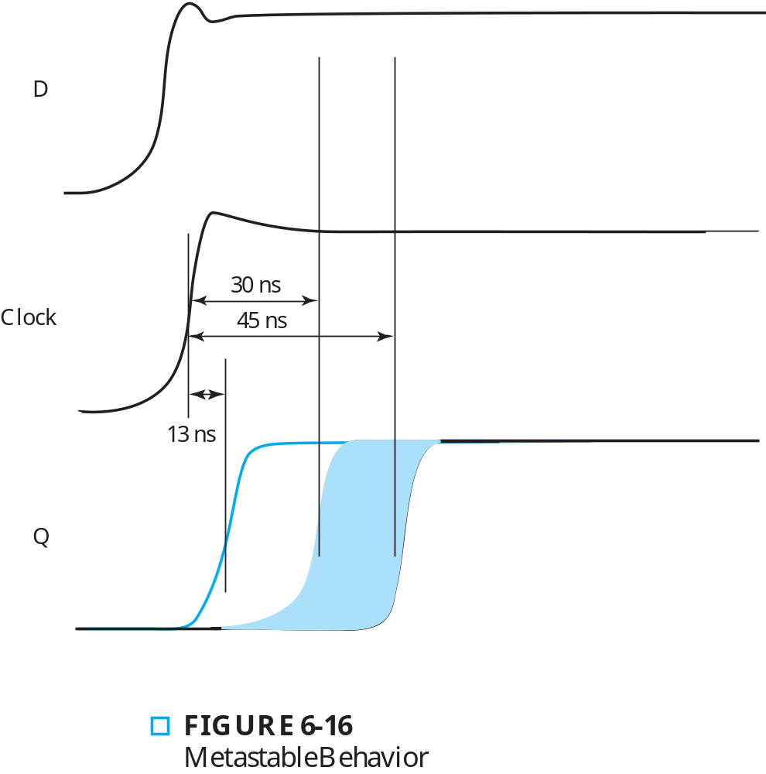
Metastable Behavior
Metastability lengthens the propagation delay to well beyond normal.

Slide 21
Metastable Behavior Consequences
If the clock period is short enough, due to the increase in delay, the change in RDY_S may reach the D inputs to the y0 and y1 flip-flops during the setup-hold interval at the next positive edge and produce inconsistent behavior.
So, metastable behavior can reintroduce a failure in spite of the presence of the synchronizer.

Slide 22
Solution to Metastable Behavior
Simple Solution: A Cascade of Synchronizers
  The metastable behavior delay of the first synchronizer is encountered by the next synchronizer.
  Due to the narrow window, it is unlikely that the next synchronizer also exhibits metastable behavior
  And so forth
Clearly each added synchronizer lowers probability of failure rather than absolutely eliminating failure
Disadvantage: May slow response to asynchronous input due to multiple clock cycles required for production of final RDY_S.
Typically, a cascade of three synchronizers in series lowers probability adequately, but depends on clock period, delays, etc.

Slide 23
Terms of Use
All (or portions) of this material © 2008 by Pearson Education, Inc.
Permission is given to incorporate this material or adaptations thereof into classroom presentations and handouts to instructors in courses adopting the latest edition of Logic and Computer Design Fundamentals as the course textbook.
These materials or adaptations thereof are not to be sold or otherwise offered for consideration.
This Terms of Use slide or page is to be included within the original materials or any adaptations thereof.

